Slide 1


#ScottishSummit2021
Thomas Stensitzki
Exchange Hybrid – What, Why, and How
LONGNIDDRY 13:00

Slide 2







Our Sponsors

Slide 3

Granikos Founder
Thomas Stensitzki
Microsoft MVP
MVP, MCT Regional Lead, Author, Blogger
@Stensitzki
in/ThomasStensitzki
JustCantGetEnough.Granikos.eu

Slide 4

“Implementing Exchange Hybrid is simple.” Undisclosed Exchange Consultant

Slide 5

What is Exchange Hybrid?
"Dieses Foto" von Unbekannter Autor ist lizenziert gemäß CC BY

Slide 6
What is Exchange Hybrid?
Trusted relationship between an on-premises Exchange Organization and Exchange Online
Hybrid connections for mail flow (SMTP), and service access (HTTPS) for Exchange hybrid functionality
Hybrid Configuration Wizard (HCW) activates and configures the hybrid mode of operation
Microsoft 365
Hybrid Configuration
Exchange Online
On-Premises Exchange Organization

Slide 7
Exchange Hybrid
Two Variants – Three Modes of Operation
Hybrid Mode
Classic
Express
Minimal
Modern
Minimal
Full
Full

Slide 8


Classic Full Hybrid
Active Directory Hybrid with Azure AD Connect
Exchange Hybrid option enabled
SMTP Connection between On-Premises and Exchange Online
Separate hostname (e.g., smtp365.company.com)
Additional public IP address
TLS certificate for hostname
Edge Transport Role in perimeter network (1)
Alternatively, direct inbound connection (2)
Inbound HTTPS connection to Client Access Service
Internal Exchange Servers published by a Reverse Proxy
Requires additional public IP address
Outbound HTTPS connections to Exchange Online
Exchange Server communication to Exchange Online
Microsoft 365
Hybrid Configuration
Exchange Online
Azure AD
HTTPS
SMTP
Perimeter Network
Company Network
On-Premises Exchange Organization

Slide 9
Modern Full Hybrid
Active Directory Hybrid with Azure AD Connect
Exchange Hybrid option enabled
SMTP Connection between On-Premises and Exchange Online
Separate hostname (e.g., smtp365.company.com)
Additional public IP address
TLS certificate for hostname
Edge Transport Role in perimeter network (1)
Alternatively, direct inbound connection (2)
Outbound HTTPS connections to Exchange Online
Exchange Hybrid-Agent Exchange Online to Exchange on-premises communication
Exchange Server communication to Exchange Online
Install additional Hybrid-Agents for redundancy
Microsoft 365
Hybrid Configuration
Exchange Online
Azure AD
HTTPS
SMTP
Perimeter Network
Company Network
On-Premises Exchange Organization

Slide 10


Exchange Hybrid
The Differences
Full
Full classic hybrid configuration, Exchange server published to the internet (SMTP/HTTPS) → permanent hybrid operation and Teams access to on-premises
Minimal
Hybrid configuration, without rich coexistence to migrate all on-premises mailboxes to Exchange Online → temporary hybrid operation for a few weeks / months
Express
Hybrid configuration, with Azure AD Connect Express settings, to migrate all on-premises mailboxes to Exchange Online → temporary hybrid operation for a few days / weeks
Full
Full Modern Hybrid configuration, for new hybrid setups based on Hybrid Agent deployment, with reduced hybrid functionality → permanent hybrid operation
Minimal
Modern Hybrid configuration, to migrate all on-premises mailboxes to Exchange Online → temporary hybrid operation for a few weeks / months

Slide 11
Why do you need Exchange Hybrid?
"Dieses Foto" von Unbekannter Autor ist lizenziert gemäß CC BY

Slide 12
Why do you need Exchange Hybrid
Coexistence between your on-premises Exchange Organization and Exchange Online
Mailbox migration to and from Exchange Online
Seamless public folder migration to Exchange Online
Microsoft Teams with on-premises mailboxes (calendar access)
Transition from an on-premises Exchange Organization to Exchange Online
Optimal migration experience for end users
Centralized mail flow for use of on-premises email solutions with user mailboxes in Exchange Online
Gateway-based S/MIME decryption/encryption, email disclaimer, archiving, journaling, …
Hybrid mail flow providing email relay functionality for on-premises legacy applications and devices with
No access to the internet
No support for TLS protocols 1.0 or 1.1
No support for SMTPAUTH user authentication
No support for SMTP modern authentication

Slide 13
Exchange Hybrid Recommendations
On-Premises Exchange Server 2019 hybrid endpoint
Microsoft Teams backend services use AutoDiscover v2 to discover on-premises EWS and REST endpoints
Client Access Endpoint accessible for Microsoft Teams backend services
Always use latest Exchange Server cumulative update
In-Place upgrade capability for Exchange Server vNEXT (H2 2021)
Use Third-Party TLS-certificate with all required subject alternate names (SAN) for incoming HTTPS connections
AutoDiscover
Exchange namespace → Exchange Virtual Directory’s external URL-Settings
Use a dedicated Third-Party TLS-certificate for SMTP when using centralized mail flow
Enable and configure OAUTH authentication using Hybrid Configuration Wizard
Exchange team provides detailed information on how to configure OAUTH manually
AutoDiscover DNS resource records for SMTP domains used for primary email addresses
Use Exchange Server 2016 if you need a coexistence server only

Slide 14
How do you implement Exchange Hybrid?
"Dieses Foto" von Unbekannter Autor ist lizenziert gemäß CC BY

Slide 15
Exchange Hybrid Requirements
Know the differences of the Exchange hybrid variants and modes of operation available
Know the mode of operation for your Exchange Organization and hybrid requirements
Have your on-premises Exchange organization ready for hybrid configuration
Install latest Exchange Server Cumulative Updates on all Exchange Servers, including Edge Transport
Have required IP addresses & DNS hostnames for the Exchange namespace set up
Verify inbound connectivity to your Exchange organization using Remote Connectivity Analyzer (RCA)
When your firewall policy is restricted for inbound traffic, add the RCA IP addresses to that policy → RCA release notes
Have Edge Transport TLS certificates installed on internal an Exchange Server for selection by HCW, when using Edge
Do NOT enable this certificate for any Exchange service
Enable Exchange Hybrid option in Azure AD Connect first

Slide 16
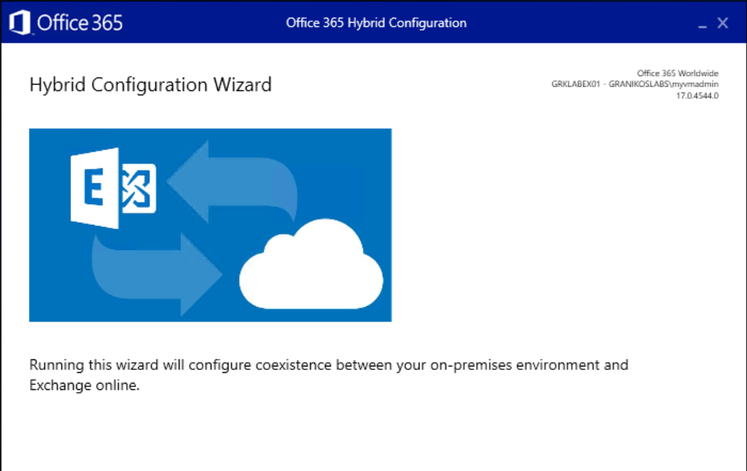
Hybrid Configuration Wizard
Click-2-Run Setup
https://aka.ms/HybridWizard
.application file type requires mapping to Internet Explorer
Note the HCW version information
Current: v17
Uninstall v16 first
HCW is updated regularly
HCW downloads a newer version automatically when started
HCW configuration steps vary depending on your Exchange Organization configuration

Slide 17
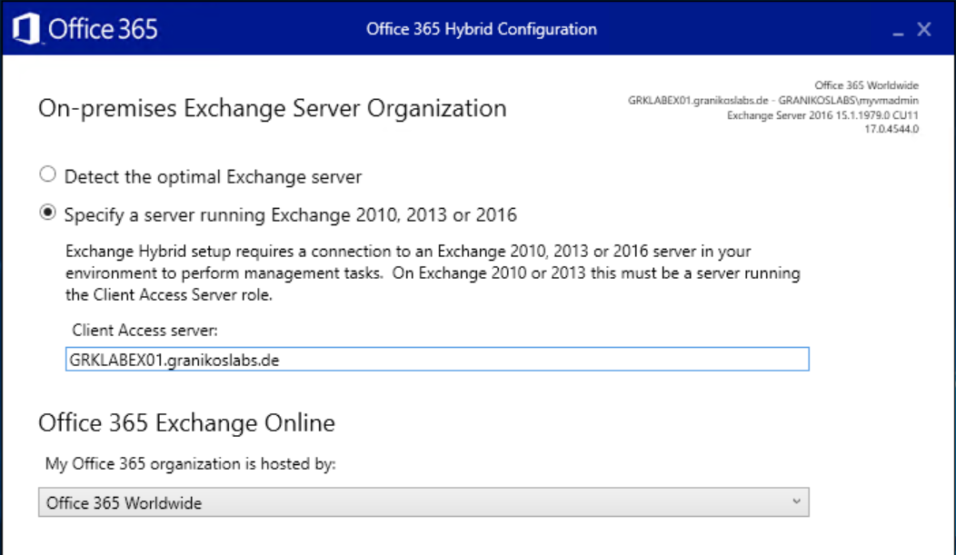
Hybrid Configuration Wizard
HCW detects the optimal Exchange Server for configuration automatically
Specify a CAS server manually, if needed
Select the appropriate Office 365 target infrastructure
Office 365 Worldwide is the default for commercial customers

Slide 18
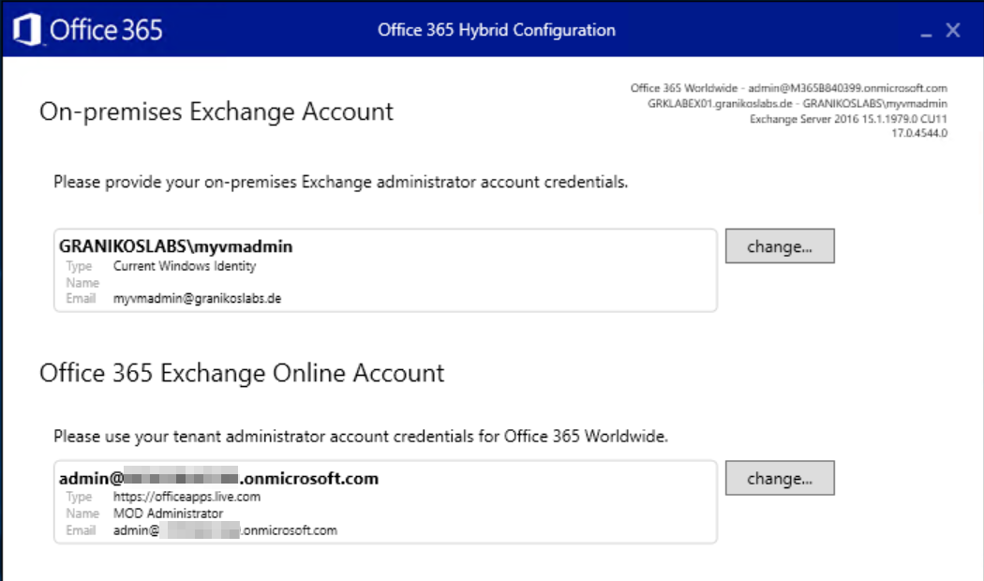
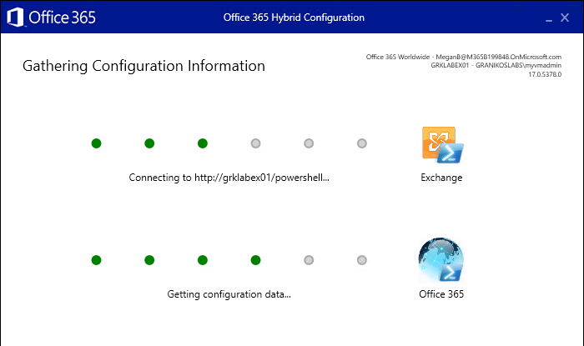
Hybrid Configuration Wizard
HCW connects to on-premises Exchange and Exchange Online to gather the current organizational configuration
Adjust credentials as needed
→ Check, if WinRM allows Basic Authentication

Slide 19
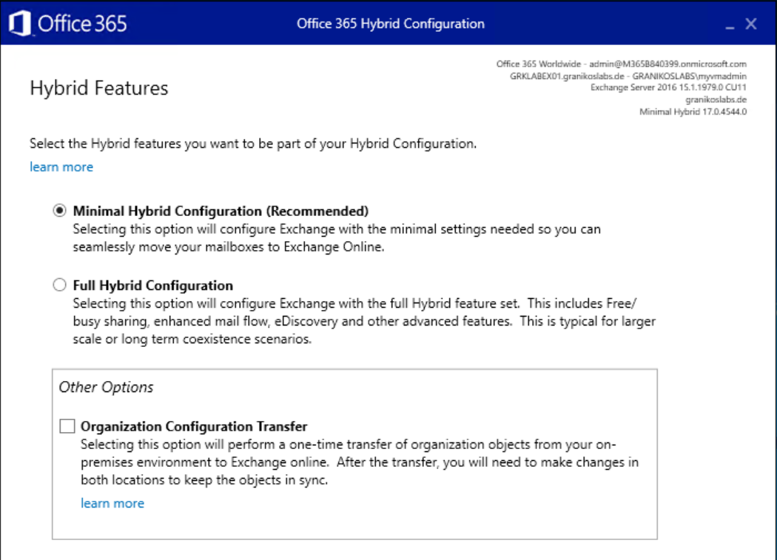
Hybrid Configuration Wizard
Select hybrid features to configure
Minimal Hybrid
Full Hybrid
Enable Organization Configuration Transfer
One-time transfer of selected configuration objects
Available objects depend on the on-premises Exchange Server version
Hybrid Organization Configuration Transfer Documentation

Slide 20
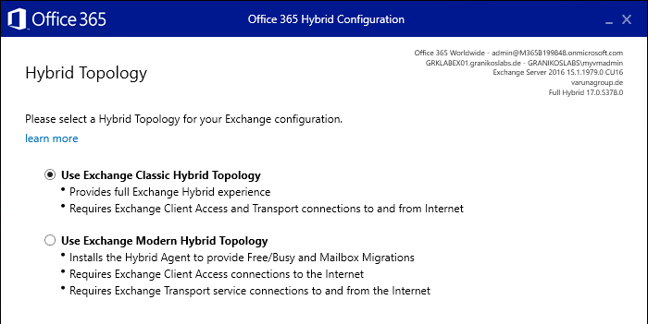
Hybrid Configuration Wizard
Select Hybrid Topology
Exchange Classic Hybrid
Exchange Modern Hybrid
Modern Hybrid uses the Modern Hybrid Agent
Azure Application Proxy-style component using HTTPS outbound connectivity only
Automatic download and installation of
Hybrid Updater
Hybrid Agent
HCW uninstalls and unregisters the Modern Hybrid Agent when switching from Modern Hybrid

Slide 21
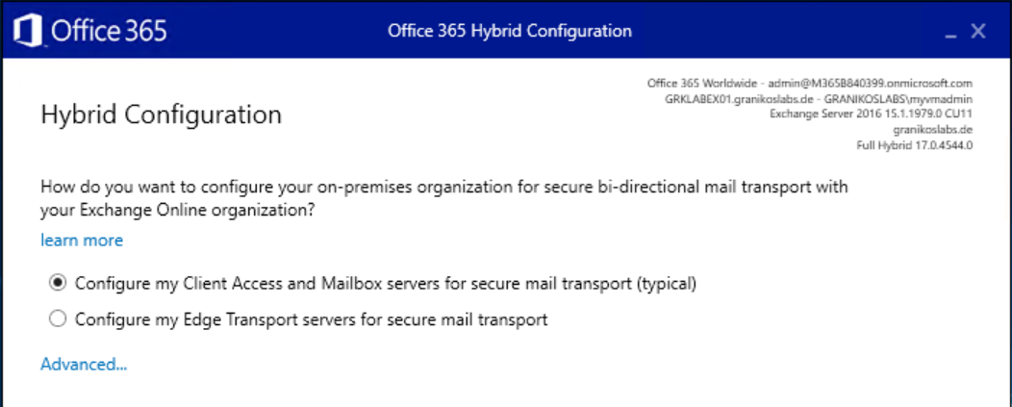
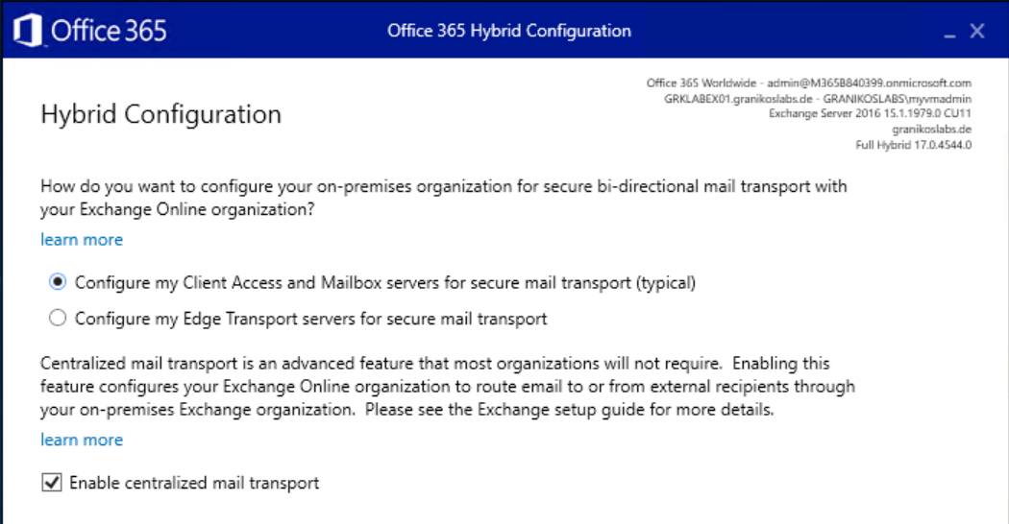
Hybrid Configuration Wizard
Configure hybrid mail flow
Direct to/from internal Exchange Servers
Via Edge Transport Servers in perimeter network, already subscribed to Active Directory site
Centralized mail flow
Route all mail flow to/from Exchange Online mailboxes via on-premises Exchange Organization

Slide 22
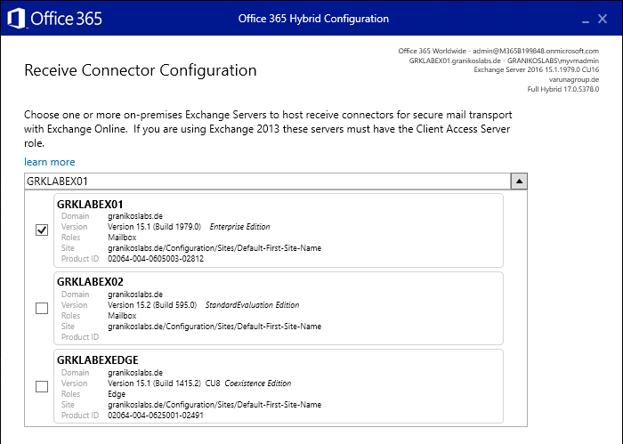
Hybrid Configuration Wizard
Select the Exchange server used for receiving email messages from Exchange Online
Select the Exchange Server published to the Internet
HCW configures the default frontend receive connector
HCW might select the wrong receive connector
You use additional receive connectors with a remote IP address range 0.0.0.0 – 255.255.255.255
The default frontend connector uses individual remote IP address ranges configuration
Compare TlsCertificateName and TlsDomainCapabilities connector properties afterwards

Slide 23
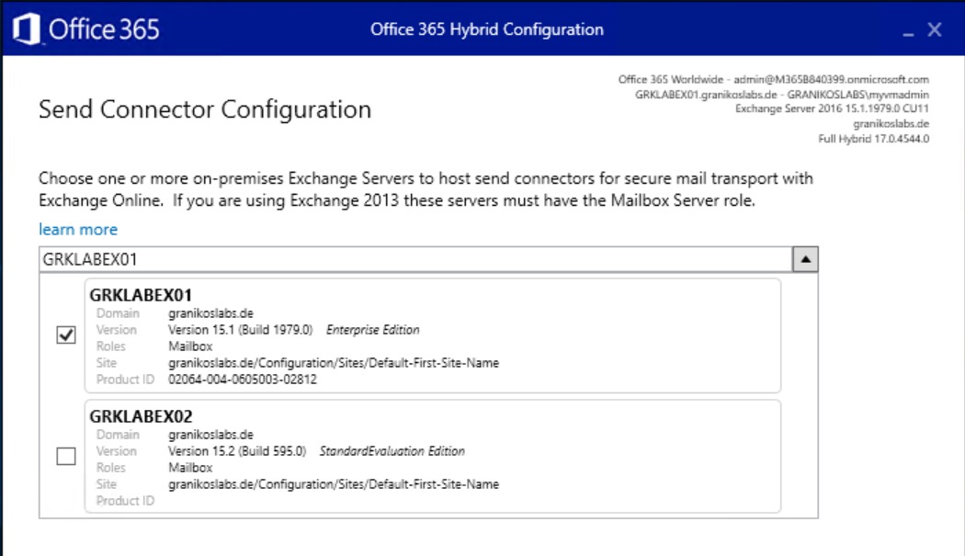
Hybrid Configuration Wizard
Select Exchange server for sending email messages from the on-premises Exchange Organization to Exchange Online
HCW configures Send Connector
Exchange Server needs outbound connectivity to Exchange Online
EdgeSync transfers the Edge Servers’ Send Connector configuration (when using Edge Transport)

Slide 24
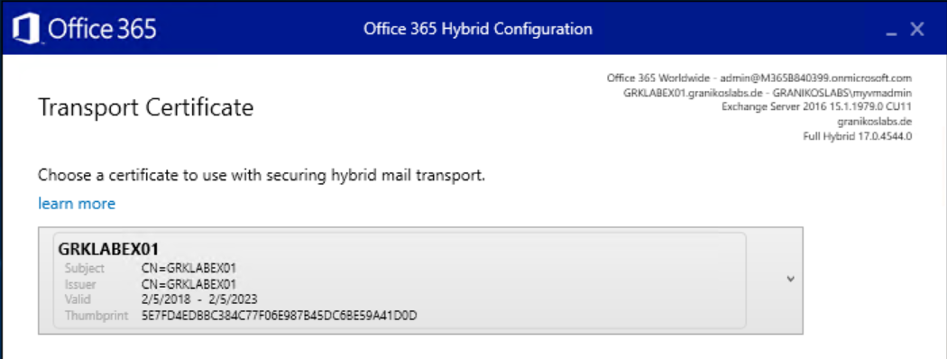
Hybrid Configuration Wizard
Select TLS certificate to secure the trusted mail flow between on-premises Exchange and Exchange Online
With Edge Transport
Ensure that the dedicated TLS certificate is installed in the certificate store of one of the internal Exchange servers
Import the TLS certificate prior to executing HCW into the local Exchange Server certificate store
Do NOT enable the TLS certificate for any Exchange service
Avoid using NAT between Edge Transport Servers and internal Exchange servers
Do NOT use TLS intercepting SMTP proxy servers

Slide 25
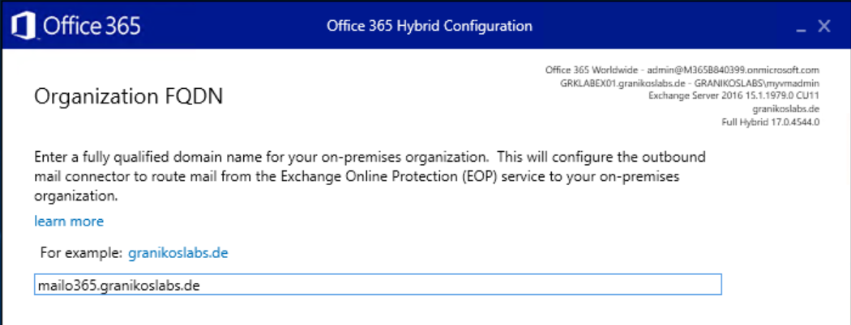
Hybrid Configuration Wizard
Enter the external FQDN of the Exchange Organization for inbound SMTP
Hostname should match TLS certificate
Hybrid mail flow requires Exchange to Exchange communication
Recommendation for centralized mail flow
Use a dedicated host name, IP address, and TLS certificate
Use Edge Transport Server(s)

Slide 26
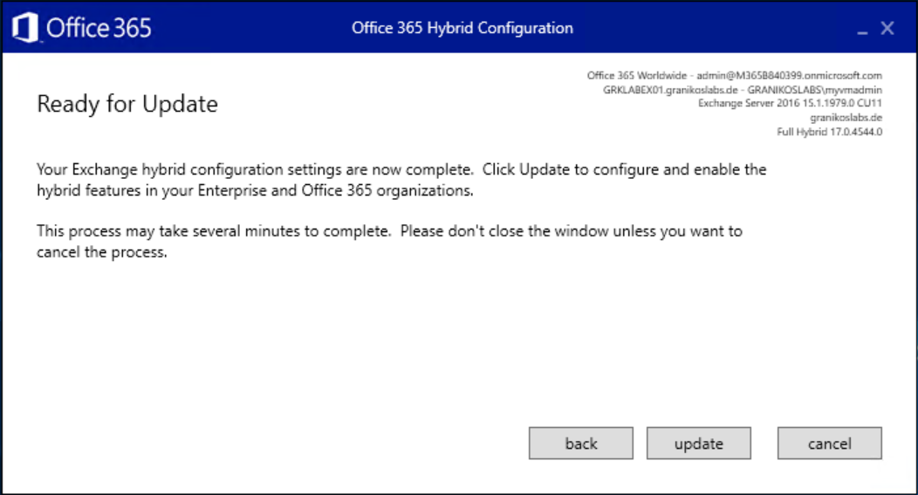
Hybrid Configuration Wizard
Update and wait
If updating fails
HCW provides full log files → %appdata%\Roaming\Microsoft\Exchange Hybrid Configuration
Log file contains all PowerShell configuration steps
Use Remote Connectivity Analyzer to check inbound connectivity
Issues
Remote connectivity → Firewall policies, proxy servers, DNS
WinRM Windows service configuration issues

Slide 27

Microsoft Teams and Exchange Server
"Dieses Foto" von Unbekannter Autor ist lizenziert gemäß CC BY

Slide 28
Microsoft Teams & Exchange
Microsoft Teams Client communicates with Teams Backend-Services, not with Exchange directly
Microsoft Teams Backend contacts Exchange Online first
If user mailbox is not in Exchange Online, the Teams Backend receives an HTTP 302 Redirect to On-Premises
On-premises endpoint is always discovered using AutoDiscover v2
Exchange Redirect requires AAD Connect synchronization with Exchange Hybrid option enabled
Authentication requires OAuth between Exchange Server and Exchange Online / Azure AD
Use Hybrid Configuration Wizard to configure OAuth (preferred)
Microsoft Teams Backend requires communication with AutoDiscover, EWS, and REST endpoints

Slide 29
Microsoft Teams & Exchange
When using many different SMTP domains you need a dedicated AutoDiscover v2 endpoint for each domain
Microsoft Teams backend services do not handle an on-premises HTTP 302 redirect correctly
Publish an AutoDiscover endpoint for each SMTP domain
Use an edge router if you cannot add all domains to a single SAN certificate, e.g., Traeffic
Check Microsoft Teams Coexistence mode with Skype for Business Online
Only Island, Teams Only, or Skype for Business with Teams Collaboration and Meeting support the calendar tab
Verify that the calendar tab is enabled in Teams App Policy
Ensure that Exchange Hybrid is enabled in Azure AD Connect

Slide 30
Thank You
#ScottishSummit2021

Slide 31
Resources
Exchange Server Hybrid Deployments
Hybrid Deployment Prerequisites
Hybrid Configuration Wizard FAQs
Configuring Teams calendar access for Exchange on-premises mailboxes
Configure OAuth authentication between Exchange and Exchange Online organizations
Demystifying and troubleshooting hybrid mail flow: when is a message internal?
Remote Connectivity Analyzer
How Exchange and Microsoft Teams interact
Traeffic Edge Router

